Slide 1

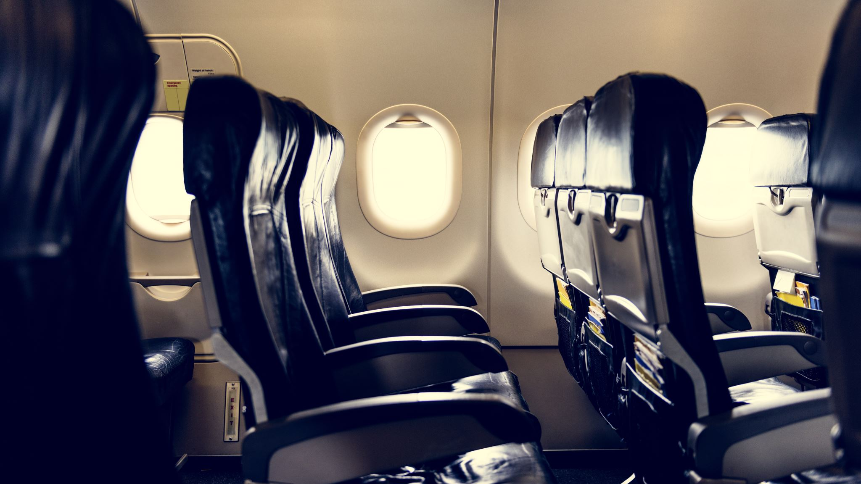
Presentation on:-
Flight Price Prediction
Presented By:-
HARSH RAJ GUPTA

Slide 2
Airline industry is one of the most sophisticated in its use of dynamic pricing strategies to maximize revenue, based on proprietary algorithms and hidden variables. That is why the airline companies use complex algorithms to calculate the flight ticket prices.
There are several different factors on which the price of the flight ticket depends. The seller has information about all the factors, but buyers are able to access limited information only which is not enough to predict the airfare prices. Considering the features such as departure time, arrival time and time of the day it will give the best time to buy the ticket.
Nowadays, the number of people using flights has increased significantly. It is difficult for airlines to maintain prices since prices change dynamically due to different conditions. That’s why we will try to use machine learning models to solve this problem. This can help airlines by predicting what prices they can maintain. It can also help customers to predict future flight prices and plan their journey accordingly.
Introduction

Slide 3
The Dataset
The training set contains the features, along with the prices of the flights. It contains 3542 records, 9 input features and 1 output column — ' Price ‘.
We have scraped data from yatra.com.
The Selenium library is used for the scraping process. After the scraping process is complete.

Slide 4
Features
Airline: The name of the airline.
Source: The source from which the service begins.
Destination: The destination where the service
Dep_Time: The time when the journey starts from the airport
Arrival Time: Time of arrival at the airport
Duration. Total duration of the journey
Total Stops: Total stops between the source and
Meal availability: meals
Price: The price of the ticket

Slide 5

Problem Statement
Anyone who has booked a flight ticket knows how unexpectedly the prices vary. The cheapest available ticket on a given flight gets more and less expensive over time. This usually happens as an attempt to maximize revenue based on -
1. Time of purchase patterns (making sure last-minute purchases are expensive)
2. Keeping the flight as full as they want it (raising prices on a flight which is filling up in order to reduce sales and hold back inventory for those expensive last-minute expensive purchases) So, you have to work on a project where you collect data of flight fares with other features and work to make a model to predict fares of flights.

Slide 6
Problem Understanding
Airlines implement dynamic pricing for their tickets and base their pricing decisions on demand estimation models. The reason for such a complicated system is that each flight only has a set number of seats to sell, so airlines have to regulate demand. In the case where demand is expected to exceed capacity, the airline may increase prices, to decrease the rate at which seats fill. On the other hand, a seat that goes unsold represents a loss of revenue and selling that seat for any price above the service cost for a single passenger would have been a preferable scenario.

Slide 7
Exploratory Data Analysis (EDA):
Checked some statistical information like shape, number of unique values present, info, data types etc.
Checked for null values and found no missing values in the dataset.
Taking care of Timestamp variables by converting data types of “Departure time” and “Time_of_arrival” from object data type into datetime data types.
Done feature engineering on some features as they had some irrelevant values and replaced them with empty spaces.
Extracted proper Duration column in terms of float data type from the difference of arrival time and departure time. Extracted Departure Hour, Deparature_Min and Arrival Hour, Arrival columns from Departure time and Time_of_arrival columns and dropped these columns after extraction.
The label “Price" should be continuous numeric data but due to some string values like “,” it was showing as object data type. So, I replaced this sign by empty space and converted into float data type.
Grouped same categories in the column Meal availability and converted categorical data into numeric data in Number_of_stops column.

Slide 8
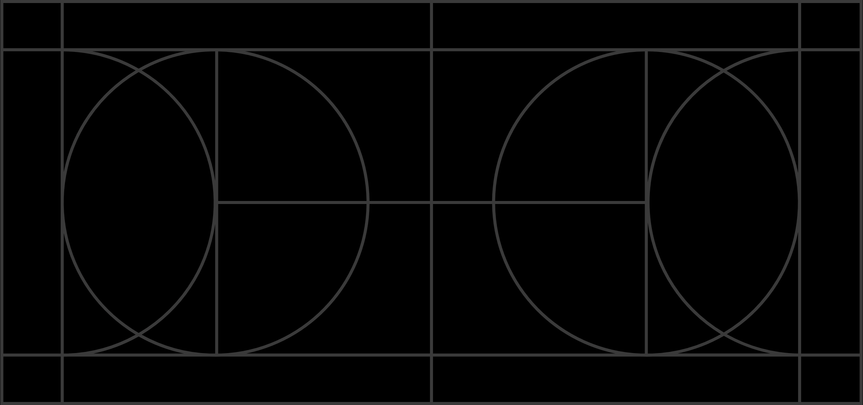
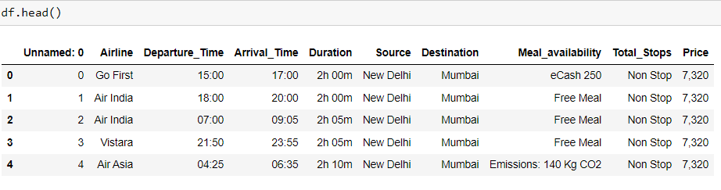
Loading Dataset

Slide 9
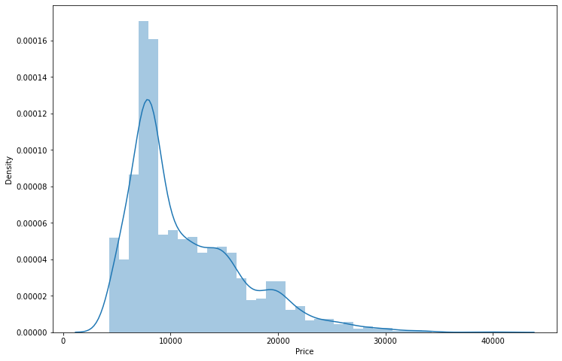
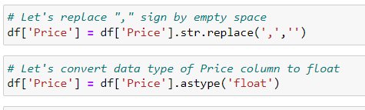
'Price' Let's replace this sign by empty space and convert the type into float.

Slide 10
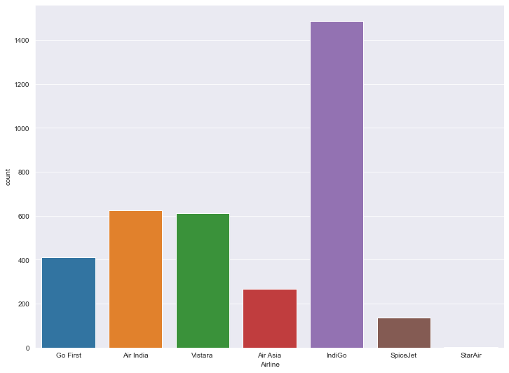
Airline
we can infer that there are more number of flights of “Indigo", "Vistara" and " Air India " compared to others. Also, the count of SpiceJet flights are very less.

Slide 11
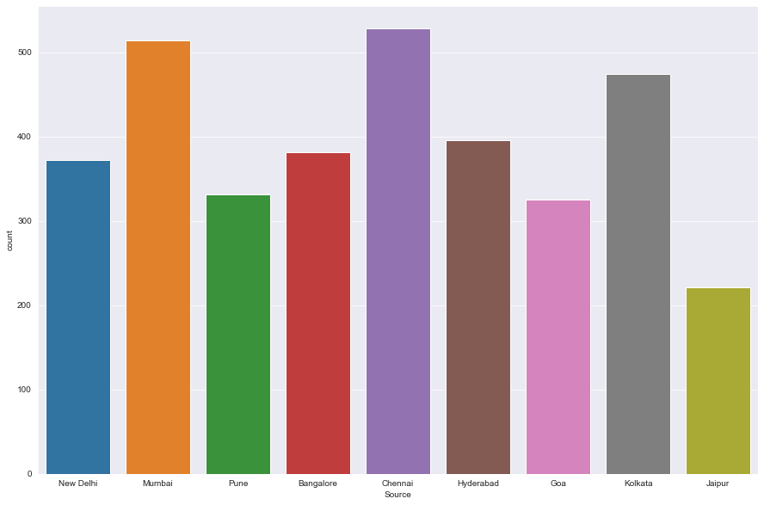
Source
we can observe more number of flights are from Chennai, Mumbai, Kolkata and Hyderabad, Bangalore. Only few flights are from Jaipur.

Slide 12
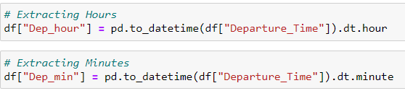
Departure Time
Departure time is when a plane leaves the gate.
"Departure Time" is an object data type. therefore, we have to convert this datatype into timestamp(datetime).

Slide 13

Arrival Time
Arrival time is when a plane leaves the gate.
"Arrival Time" is an object data type. therefore, we have to convert this datatype into timestamp(datetime).

Slide 14
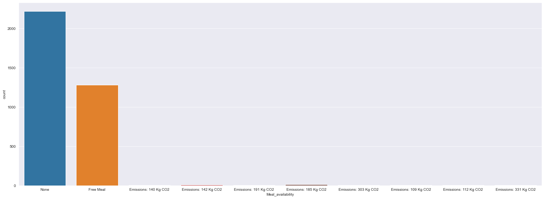
Meal availability
Most of the flights providing free meals and only few flights are not providing any meals.

Slide 15
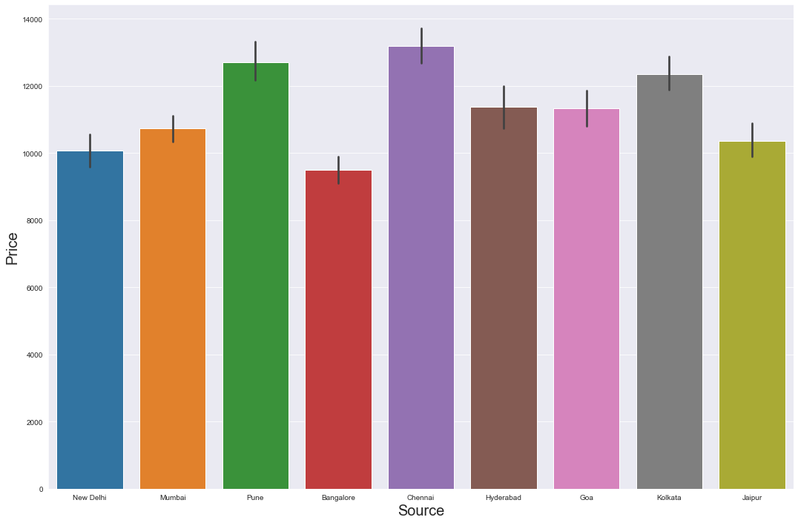
Source vs Price
we can observe the flights from Pune and Chennai and Kolkata are having somewhat higher prices compared to other sources.

Slide 16
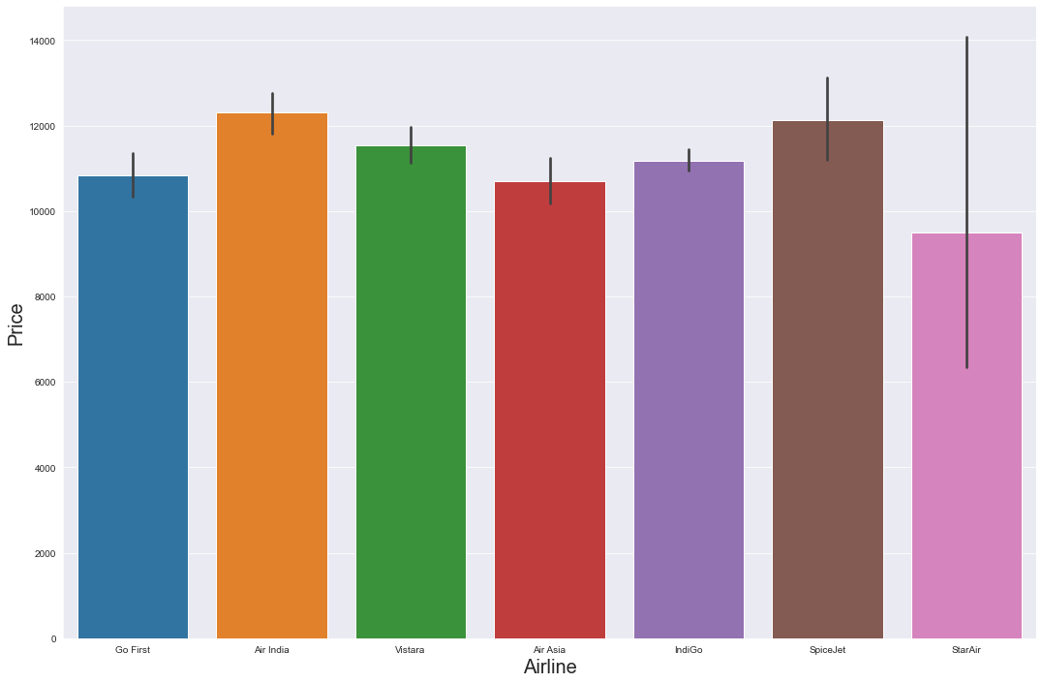
"Airline" vs "Price"
we can notice “SpiceJet" and "Air India" airlines have highest ticket prices compared to other airlines.

Slide 17
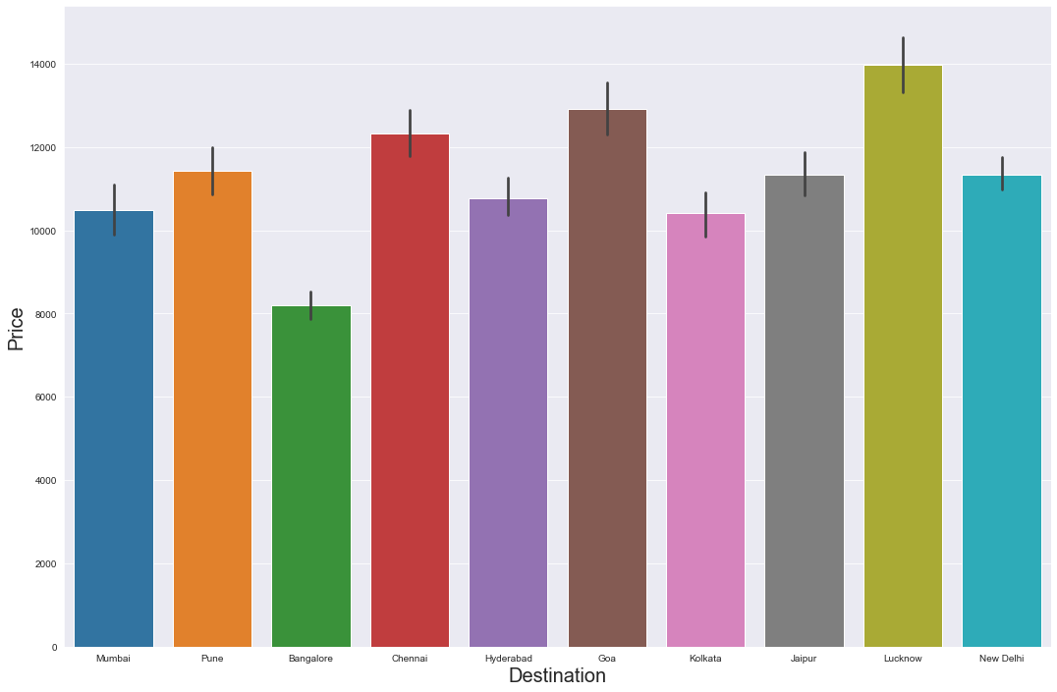
"Destination" vs "Price"
we can notice that the flights travelling to Goa have higher flight ticket prices.

Slide 18
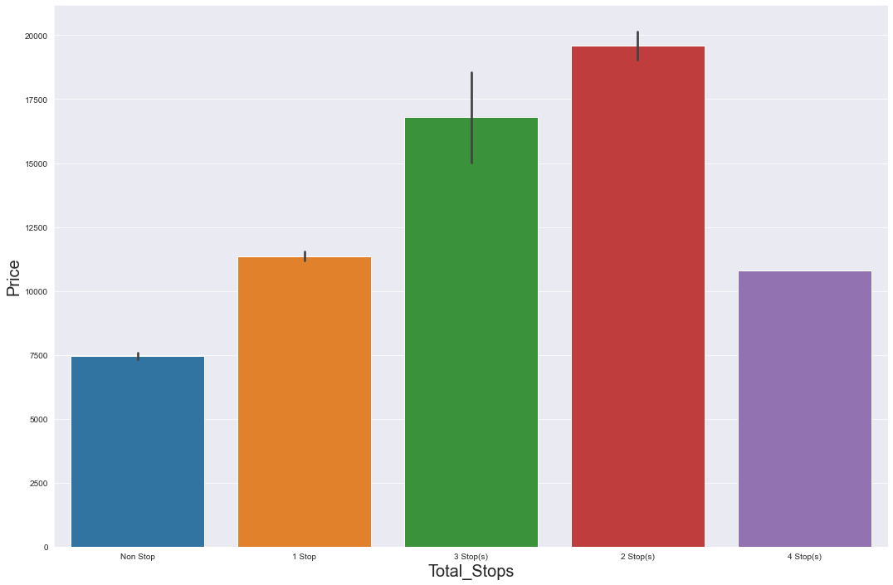
"Total Stops" vs "Price"
we can notice the flights which have 2 and 3 stops between source and destination have highest ticket prices compared to others. The airlines which have 4 stops during the journey have very less ticket price. So, we can say as the stops increases, ticket price

Slide 19
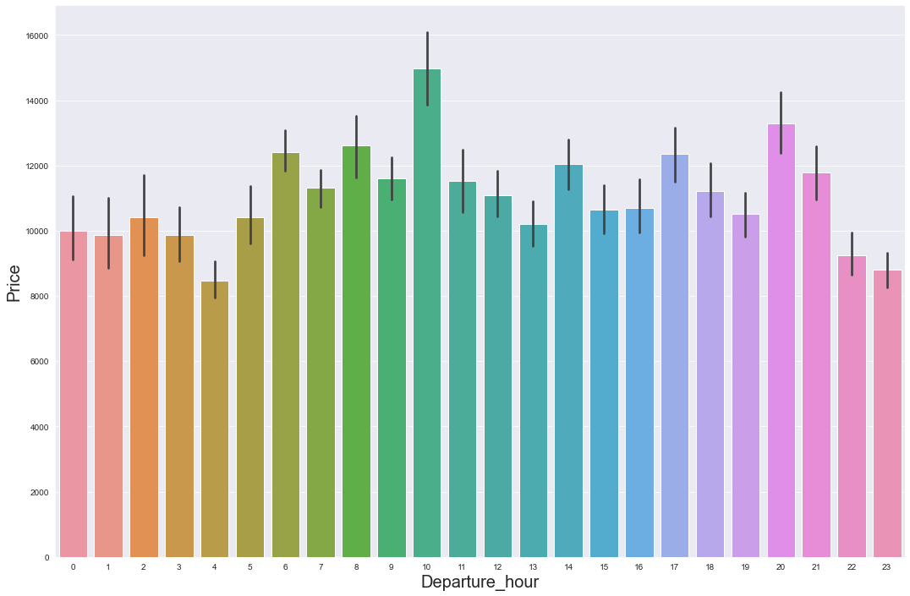
"Dep_hour" vs "Price"
we can see that there are some flights departing in the morning 10 AM having most expensive ticket prices compared to early morning flights. We can also observe the flight ticket prices are higher during afternoon (may fluctuate) and it decreases in the evening.

Slide 20
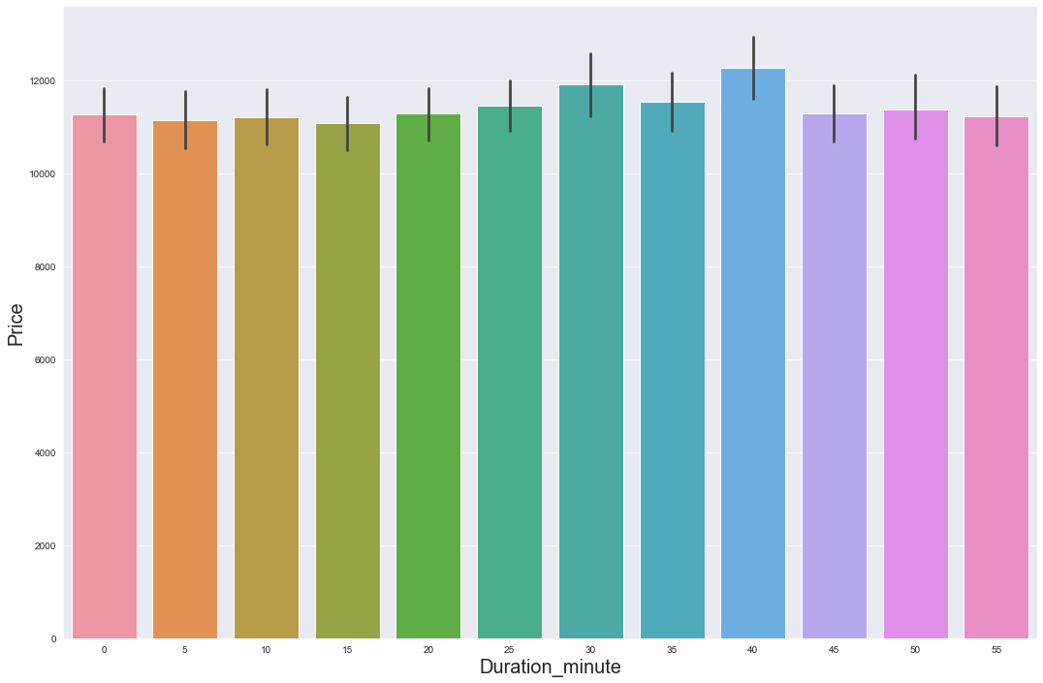
"Duration_min" vs "Price"

Slide 21
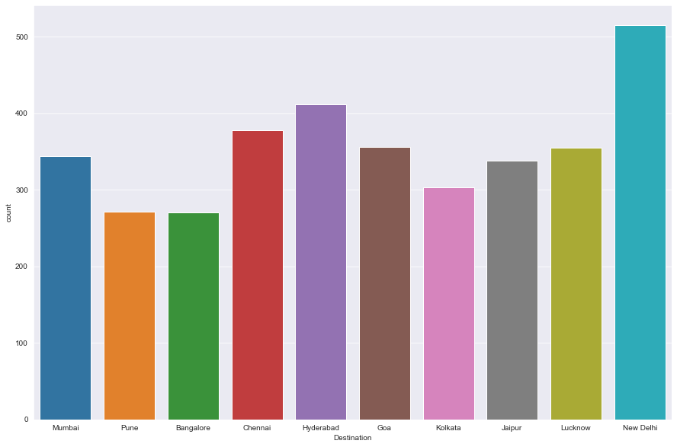
"Destination"
More number of flights are heading towards New Delhi, Hyderabad, Chennai and Mumbai. Only few flights are travelling to Hyderabad.

Slide 22
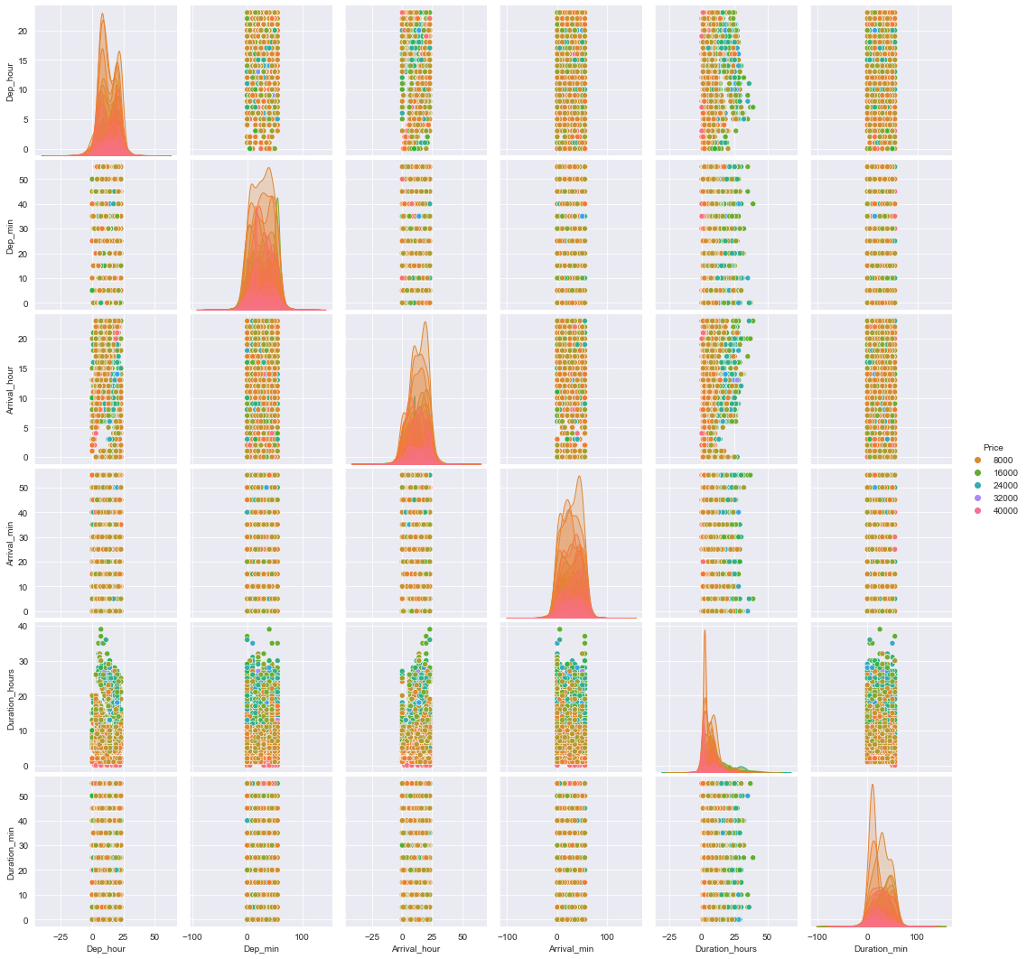
PairPlot

Slide 23
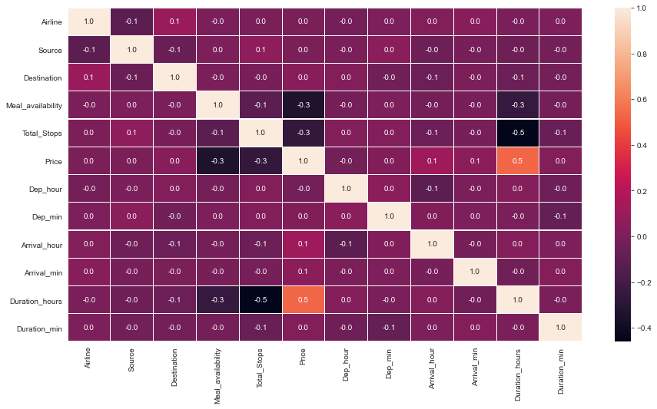
Correlation Between Features and Label
From the heat map we can clearly observe the positive and negative correlation between the label and features. From the heat map we can notice that the light shades are highly positively correlated and dark shades are highly negatively correlated with the target variable.

Slide 24
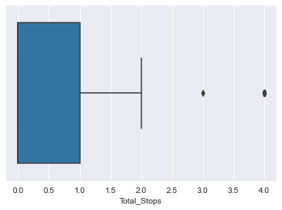
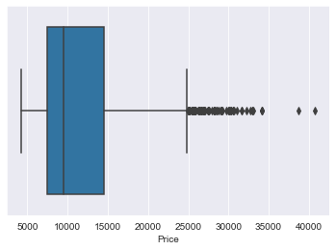
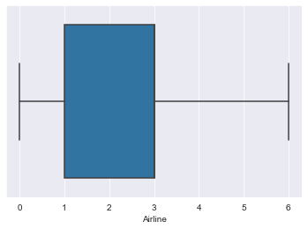
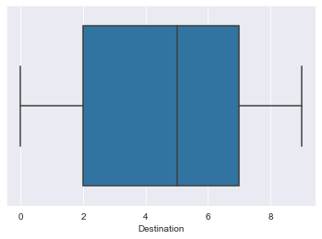
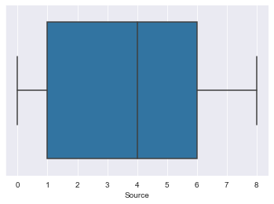
Identifying the outliers using box plot
A box plot is used to summarize data sets by using the box and whisker plot method. This function helps to understand the data summary properly. Box plots can be very useful when we want to know how the data is distributed and spread. Three types of quartiles are used in the box plot to plot the data. These values include the median, maximum, minimum, upper-quartile, and lower-quartile statistical values. A box plot summarizes this data in the 25th, 50th, and 75th percentiles.
From the box plot we can notice the outliers present in Total stops and "Price" columns.
Since Price is our target column and Total stops is our categorical variable so no need to remove outliers in this columns. Finally, there is no need to remove outliers in the dataset

Slide 25
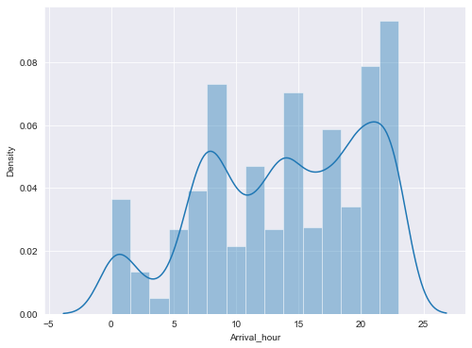
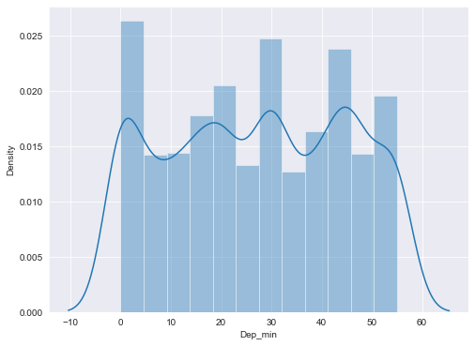
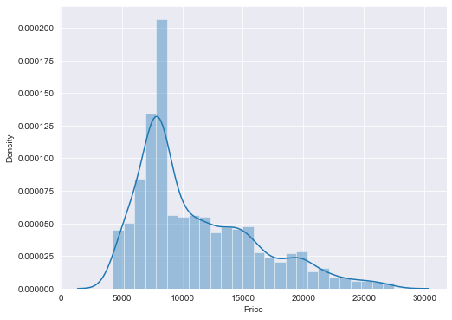
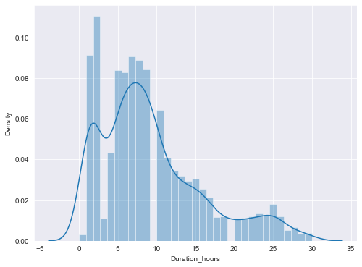
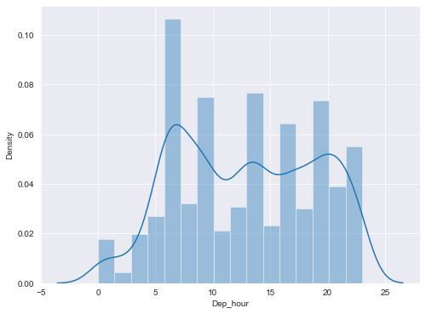
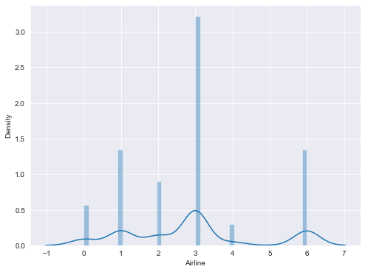
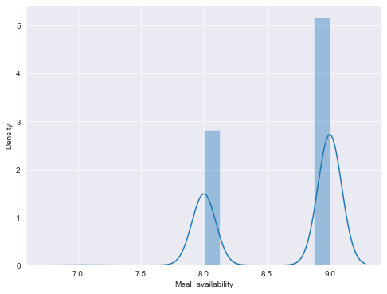
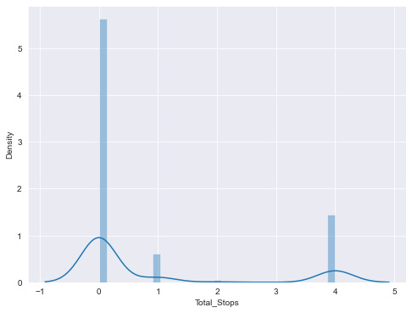
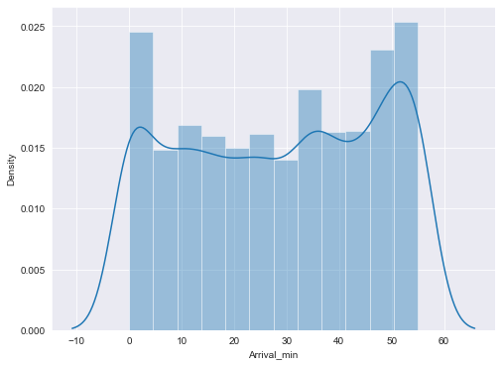
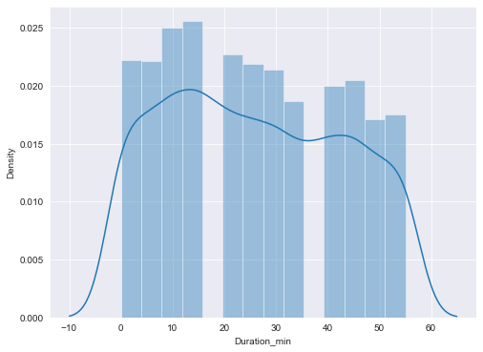
Plotting Skewness

Slide 26
Observations
1.From the distribution plot we can observe the columns are somewhat distributed normally as they have no proper bell shape curve.
2.The columns like "Duration_hour", "Total_Stops" and "Price" are skewed to right as the mean value in these columns are much greater than the median(50%).
3.Also the data in the column Arrival_Hour and Arrival_min skewed to left since the mean values is less than the median.
4.Since there is presence of skewness in the data, we need to remove skewness in the numerical columns to overcome with any kind of data biasness.

Slide 27
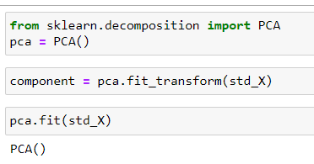
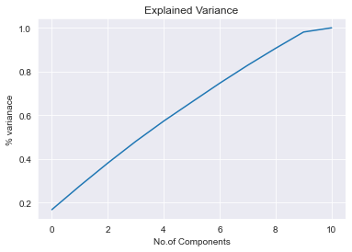
Principle Component Analysis

Slide 28
I have done feature engineering steps like feature extraction and feature selection to improve data normality and linearity.
Identified outliers using boxplots and found no outliers in numerical variables.
Identified skewness using distribution plots and removed skewness using square root transformation method.
I have used Standard Scalar method to scale the data to overcome with the issue of data biasness.
Split train and test to build machine learning models. Found best random state and best accuracy. Model building process will be shown in the further steps.
Data Analysis Steps done

Slide 29
Assumptions:
Firstly, from the problem statement we got to know that it is a Regression type problem for which we used Regression algorithms to build the model and predicted the price of flight tickets by collecting the from yatra.com using web scraping.
Secondly, from the distribution plots I found skewness in Duration column and from box plots I found outliers in target column and categorical column. Also, based upon the analysis and visualization part we have seen some of the features having somewhat linear relation with label. So, I assumed these features helps in model building and to predict price of the flight tickets. Also, this model helps the buyers to understand the future price of the flight tickets.
So, I suggest that the sellers and buyers take this model into consideration the features that were deemed as most important as seen in this study might help them estimate the flight ticket price.

Slide 30
Model Building:
In this problem “Price” is our target variable which is continuous in nature where we need to predict the price of flight tickets. From this I can conclude that it is a Regression type problem hence I have used following regression algorithms.
After the pre-processing and data cleaning I left with 11 columns including target and with the help of feature importance bar graph I used these independent features for model building and prediction. The algorithms used on training the data are as follows:
Ridge
Decision Tree Regressor
Random Forest Regressor
XGBRegressor
GradientBoostingRegressor
KNeighborsRegressor

Slide 31
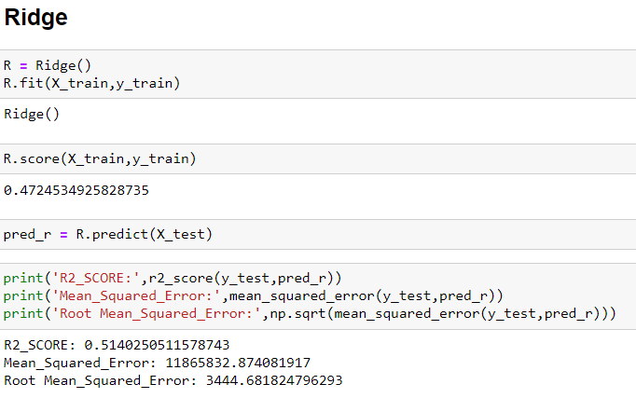
Ridge
Created Ridge model and checked for its evaluation metrics. The model is giving R2 score as 51.40%.

Slide 32
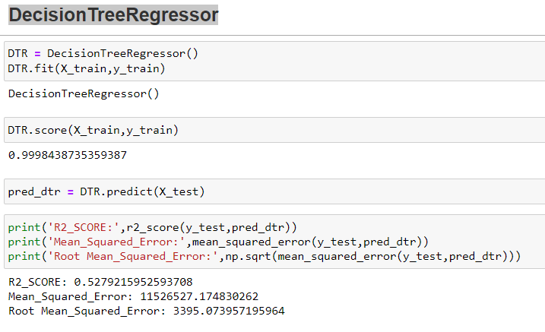
Decision Tree Regressor
Created Decision Tree Regressor model and checked for its evaluation metrics. The model is giving R2 score as 52.79%.

Slide 33
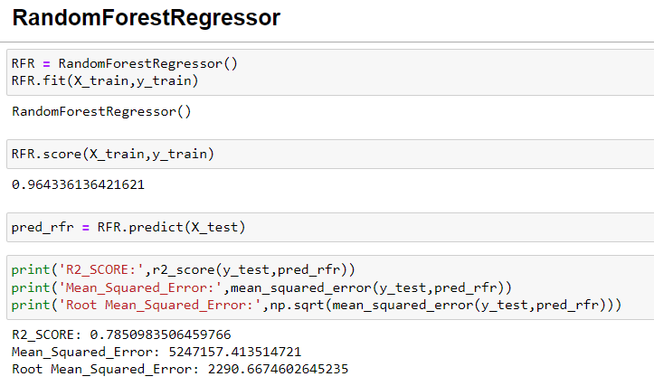
Random Forest Regressor
Created Random Forest Regressor model and checked for its evaluation metrics. The model is giving R2 score as 78.50%.

Slide 34
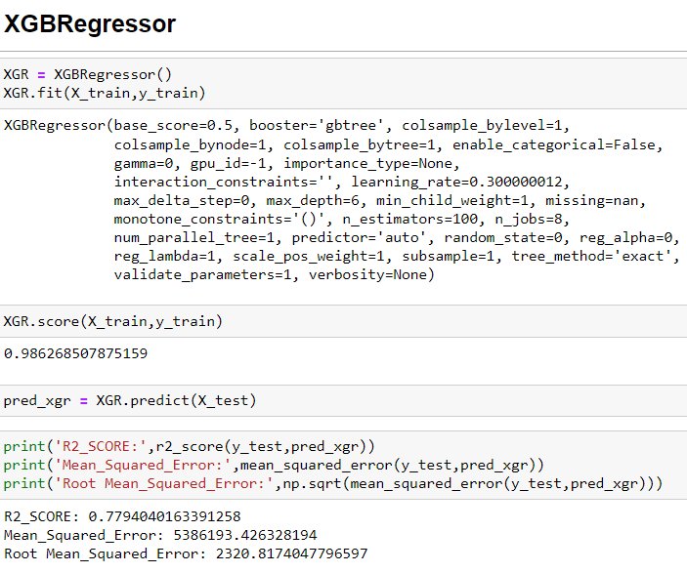
XGBRegressor
Created XGB Regressor model and checked for its evaluation metrics. The model is giving R2 score as 77.97%.

Slide 35
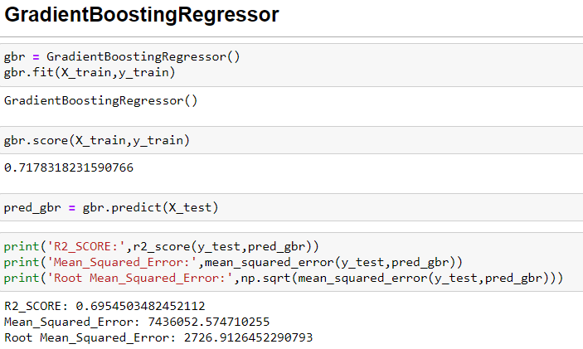
GradientBoostingRegressor
Created Gradient Boosting Regressor model and checked for its evaluation metrics. The model is giving R2 score as 69.54%.

Slide 36
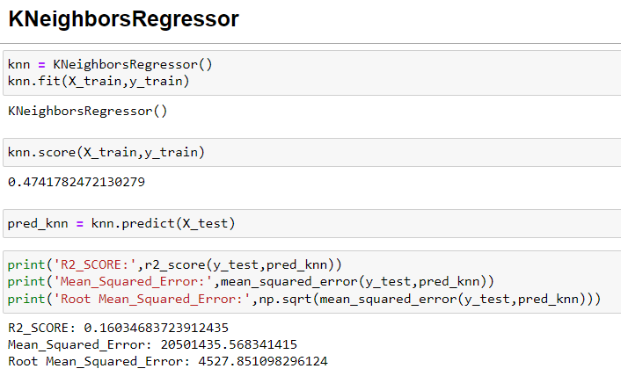
KNeighborsRegressor
Created KNeighbour Regressor model and checked for its evaluation metrics. The model is giving R2 score as 16.03%.

Slide 37
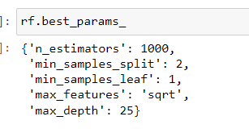
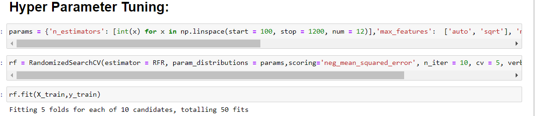
Hyperparameter Tuning:
From the above created models, Random Tree Regressor algorithm has high R2 score and less RMSE value. So, we can conclude that "Random Tree Regressor" as the best fitting model. Let's try to increase our model score by tuning the best model using different types of hyper parameters.

Slide 38
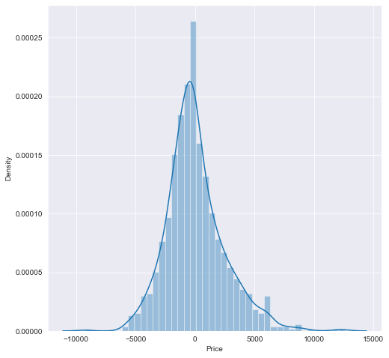
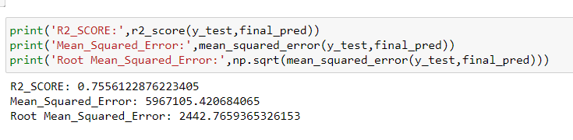
Creating Final Model After Tuning:
I have successfully incorporated the hyper parameter tuning using best parameters of Random Forest Regressor and the R2 score of the model has been increased after hyperparameter tuning and received the R2 score as 75.56% which is very good.
From the graph we can observe how our final model is mapping.

Slide 39
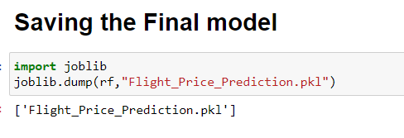
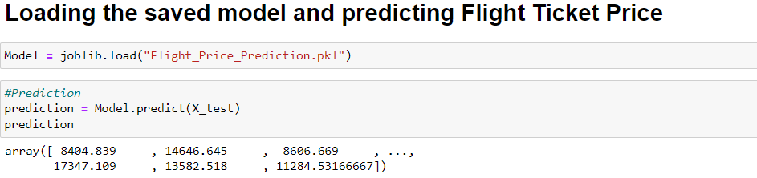
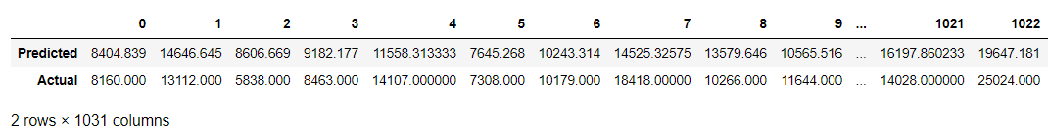
Saving The Final Model And Predictions From Saved Model
I have saved my final best model using joblib library in .pkl format and loaded saved model for predictions.
Using regression model, we have got the predicted price of the flight tickets. From the above output we can observe that predicted values are almost near to the actual values.

Slide 40
Conclusion:
The case study aims to give an idea of applying Machine Learning algorithms to predict the price of the flight tickets. After the completion of this project, we got an insight of how to collect data, pre-processing the data, analyze the data, cleaning the data and building a model.
First, we collected the flights data from yatra.com and it was done by using Web scraping. The framework used for web scraping was Selenium, which has an advantage of automating our process of collecting data. We collected almost 3542 of data which contained the ticket price of the flights and other related features. Then, the scrapped data was saved in a excel file so that we can use further and analyze the data.
Then we loaded the dataset and have done data cleaning, EDA process and pre-processing techniques like checking outliers, skewness, correlation, scaling data etc. And got better insights from data visualization.
From the visualizations we got to know that flight ticket prices change during morning and evening time of the day. From the distribution plots we came to know that the prices of the flight tickets are going up and down, they are not fixed at a time. Also, from this graph we found prices are increasing in large amounts. Also, from categorical and numerical plots we found that the prices are tending to go up as the time is approaching from morning to evening. From the categorical plots (bar and box) we came to know that early morning and late-night flights are cheaper compared to working hours. From the categorical plots we found that the flight ticket prices increases as the person get near to departure time. That is last minute flights are very expensive. From the bar plot we got to know that both Indigo and Spicejet airways almost having same ticket fares.

Slide 41


